Slide 1
Python Calculator
By Rishika Sharma

Slide 2
Tools & Technologies
Core Python
tkinter Library
Visual Studio Code[IDE]
GitHub
Application development using Python programming language

Slide 3
Functionality in Calculator
Supports basic operations: Addition, Subtraction, Multiplication, Division.
Clear functionality.
Simple and lightweight application.
Personal use for quick calculations.

Slide 4
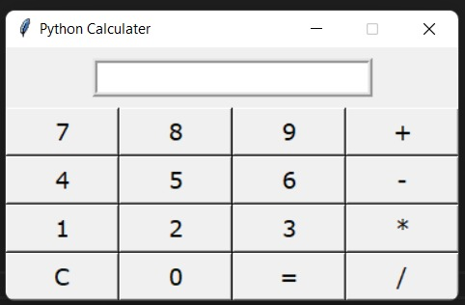
Calculator

Slide 5
Challenges Faced
Layout alignment issues.
Exception handling (e.g., division by zero).
UI/UX design improvements.

Slide 6
Thank You
Presented by: Rishika sharma

